Slide 1
Downstream Analysis in R
Niels W. Hanson
Ph.D. Candidate Bioinformatics
Wednesday, February 12 2014
Hallam Laboratory
Hydrocarbon MetaPathways Workshop
The University of British Columbia, Vancouver

Slide 2
Prerequisites
Install Pathway Tools http://biocyc.org/download-bundle.shtml
Perl v5.0 http://www.perl.org/
Downloads
Presentation Slides: MetaPathways_Tutorial_Pathway_Analysis.pdf
HOT Fosmid-end ePGDBs: HOT_Sanger_ePGDBs.zip
Perl Pathway Extractor Script: extract_pathway_table_from_pgdb.pl
ORF Abundance Tables: 1_upper_euphotic_rxn.wide.txt, HOT_Sanger_rxn.wide.txt

Slide 3
Goals of Tutorial
Understand general problems when trying to load tabular formats in R.
Re-ordering data & Subsetting Data Frames
Understanding the 'wide' and 'long' table formats
Using Visualization Frameworks: ggplot2 and lattice

Slide 4
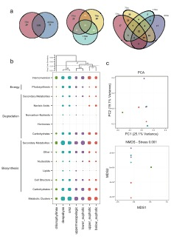

Slide 5
1. Loading Data
Data should be tab-delimited text
pathways_wide <- read.table("../files/HOT_Sanger_pwy.wide.txt", sep="\t", header=T, row.names=1)
hot_metadata <- read.table("../files/HOT_Sanger_ex_var.csv.txt", sep="\t", header=T)
Want to check head(), tail(), and dim() for size in case of bad parsing
Avoid these guys: ;’”`
slicing and dicing with brackets [] and logic
# slicing and dicing
pathways_wide[1,] # first row
pathways_wide[,1] # first column
logic operators generates Boolean vector
pathways_wide[,1] > 1
[1] FALSE FALSE FALSE FALSE TRUE FALSE FALSE FALSE FALSE TRUE TRUE FALSE FALSE
[14] TRUE FALSE
sum( pathways_wide[,1] > 1 ) gives you the number of TRUE fields

Slide 6
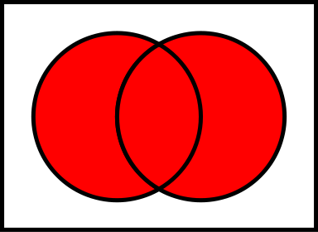
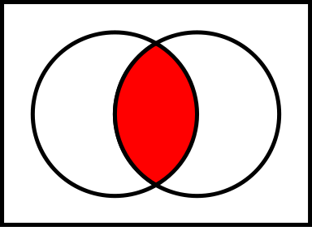
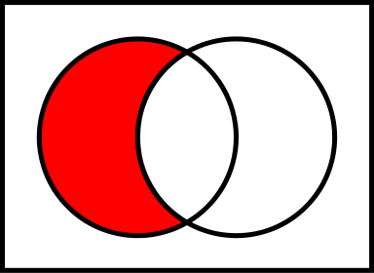
Application: Venn Diagrams
venn_diagram2(), venn_diagram3(), venn_diagram4()
created to do all the set-logic between sets and produce a Venn Diagram
e.g., union, intersect, setdiff
venn_diagram3(setA, setB, setC, “name1”, “name2”, “name3”,
colors = c("#B80830","#EACC33","#46E2D9")
)
combine c() function probably one of the most common in R, used to make a list of arguments. Used everywhere.

Slide 7
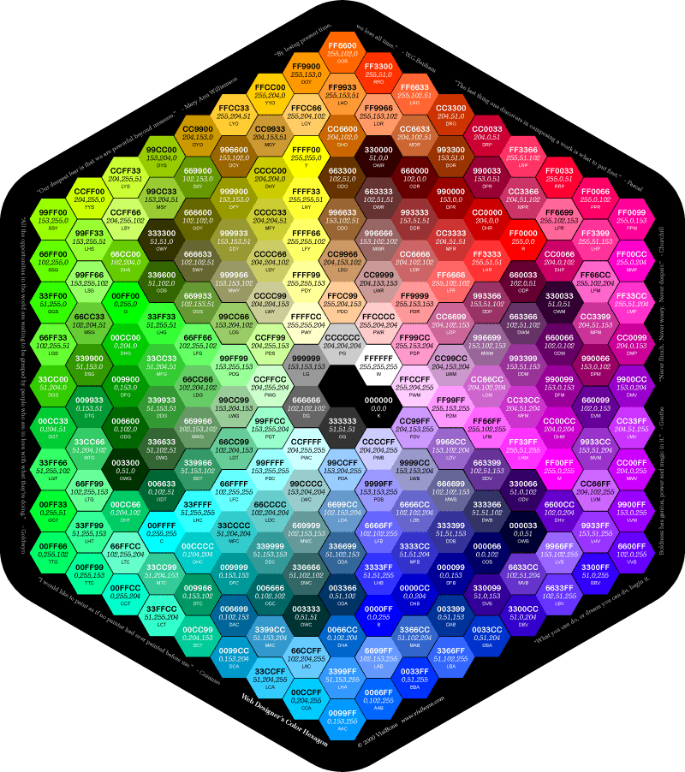
Application: Venn Diagrams
precise colors specified by six hex digits 0-9, A,B,C,D,F #FFFFFF for amounts of red green and blue. Don’t need to memorize, just use for precision.
Get a color picker

Slide 8
Application: Venn Diagrams
# use our newly found skills to identify which pathways had a signal in each
# sample
pwys_10m <- rownames(pathways_wide)[pathways_wide[,"X1_upper_euphotic"] > 0]
pwys_70m <- rownames(pathways_wide)[pathways_wide[,"X6_upper_euphotic"] > 0]
pwys_130m <- rownames(pathways_wide)[pathways_wide[,"X2_chlorophyllmax"] > 0]
pwys_200m <- rownames(pathways_wide)[pathways_wide[,"X3_below_euphotic"] > 0]
pwys_500m <- rownames(pathways_wide)[pathways_wide[,"X5_uppermesopelagic"] > 0]
pwys_770m <- rownames(pathways_wide)[pathways_wide[,"X7_omz"] > 0]
pwys_4000m <- rownames(pathways_wide)[pathways_wide[,"X4_deepabyss"] > 0]
# We can now use these as inputs to the our venn_diagram scripts
venn_10m_and_4000m <- venn_diagram2(pwys_10m, pwys_4000m,
"10m", "4000m")
venn_10m_70m_130m <- venn_diagram3(pwys_10m, pwys_70m, pwys_130m,
"10m", "70m", "130m")
venn_500m_770m_4000m <- venn_diagram3(pwys_500m, pwys_770m, pwys_4000m,
"500m", "770m", "4000m")
venn_10m_70m_130m_200m <- venn_diagram4(pwys_10m, pwys_70m, pwys_130m, pwys_200m,
"10m", "70m", "130m", "200m")
venn_200m_500m_770m_4000m <- venn_diagram4(pwys_200m, pwys_500m, pwys_770m, pwys_4000m,
"200m", "500m", "770m", "4000m")

Slide 9
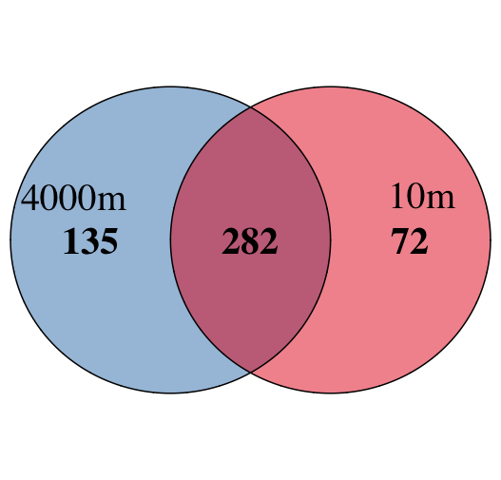
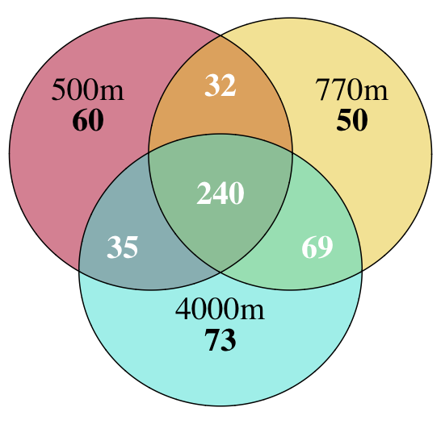
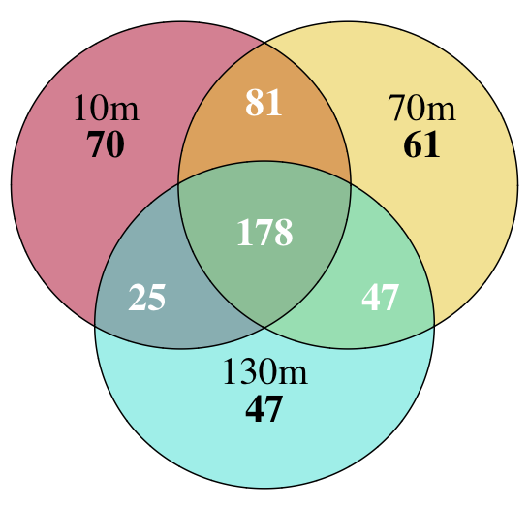
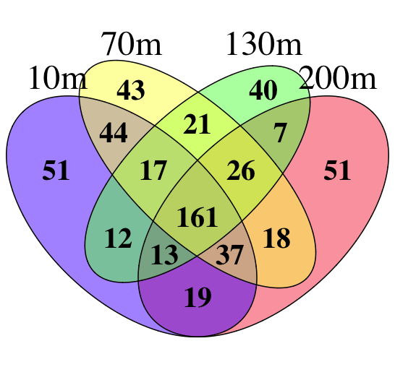
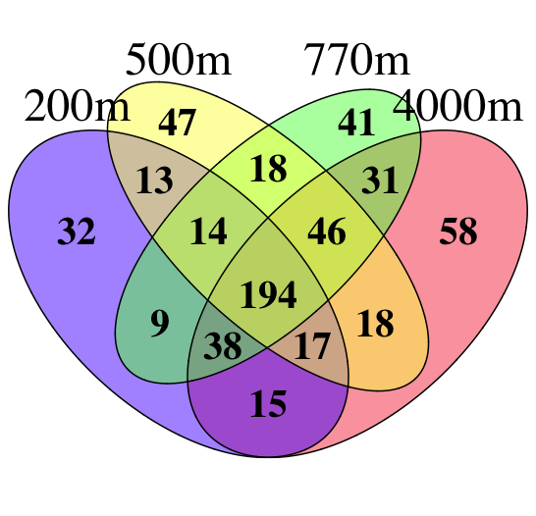
Application: Venn Diagrams

Slide 10
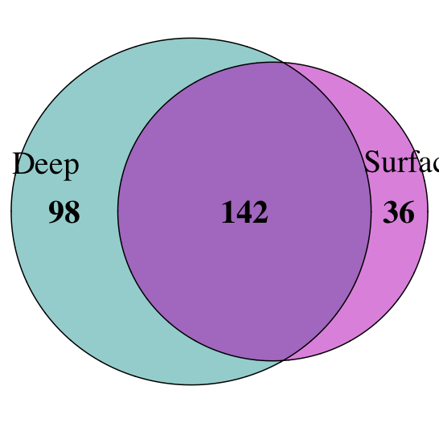
Application: Venn Diagrams
venn_diagram scripts return a list of all sets defined by combining names of sets: - name1_name2: means the intersection of name1 and name2 - name1_only: means only pathways contained in set name1
this can be used to compare the cores of our two triple sets
my_colors = c("#96B4D4", "#ED808B") # custom colors
compare_cores <- venn_diagram2(venn_500m_770m_4000m$"500m_770m_4000m", venn_10m_70m_130m$"10m_70m_130m",
"Deep", "Surface", colors=my_colors, euler=TRUE)

Slide 11
Data distributions
use hist and density to check distribution of data
par(mfrow=c(2,3)) # ready to six images 2x3
pathways_wide.matrix <- as.matrix(pathways_wide)
hist(pathways_wide.matrix)
hist(log(pathways_wide.matrix+1))
hist(sqrt(pathways_wide.matrix))
plot(density(pathways_wide.matrix))
plot(density(log(pathways_wide.matrix+1)))
plot(density(sqrt(pathways_wide.matrix)))
par(mfrow=c(1,1)) # need to set back to 1x1 at end

Slide 12
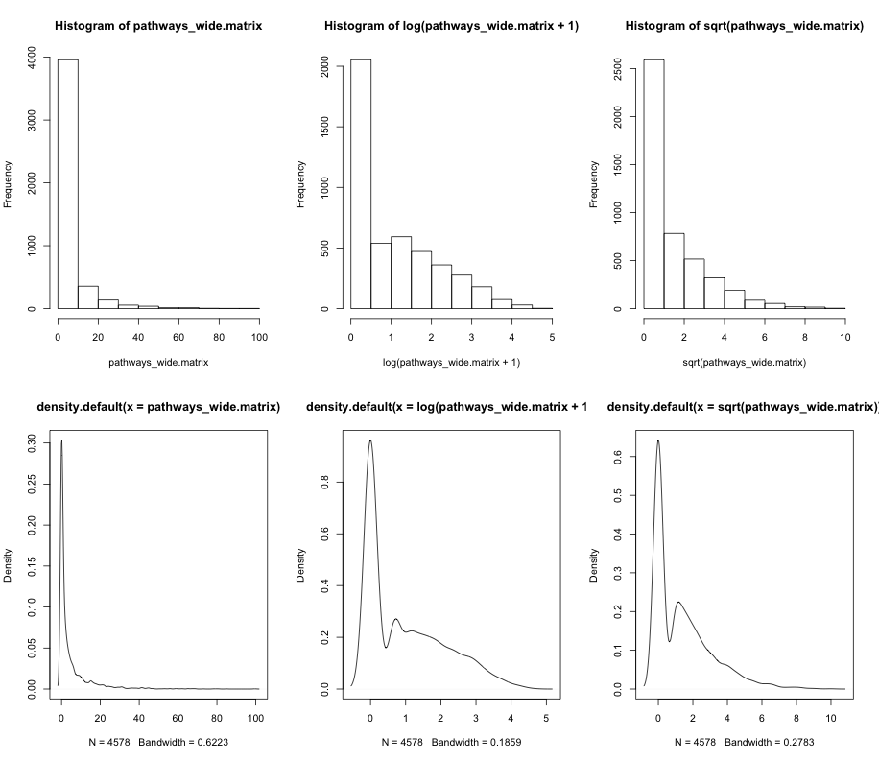
Data distributions
hist()
density()

Slide 13
ggplot2
“Wide” Table Format
 | sample1 | sample2 | sample3
taxa1 | 2 | 5 | 4
taxa2 | 4 | 6 | 9
taxa3 | 2 | 5 | 7
Good for clustering with hclust(), pvclust()
Also valuable to know the transpose t() fxn
Good to have taxa in some kind of acceptable order
“Long” Table Format
taxa | sample | value
taxa1 | sample1 | 2
taxa1 | sample1 | 4
taxa1 | sample1 | 2
taxa2 | sample2 | 5
taxa2 | sample2 | 6
taxa2 | sample2 | 5
taxa3 | sample3 | 4
taxa3 | sample3 | 9
taxa3 | sample3 | 7
Good for plotting in visualization libraries ggplot() and lattice() which need to be classified as a measured or categorical variable

Slide 14
wide to long
To prepare to use ggplot2 and lattice packages. We are going to transform our wide table to a long table format using melt() from the reshape2 package
# add pathways from rowsnames to matrix
pathways_wide$pwy = rownames(pathways_wide)
# go from wide to long table format
pathways_long <- melt(pathways_wide)
colnames(pathways_long)[2] = "samp”
pathways_long$samp <- sub("X","", pathways_long$samp)
# add long pathway names
meta_17 <- read.table("../files/meta_17.txt", sep="\t", header=T, row.names=1)
pathways_long$pwy_long = meta_17[pathways_long$pwy,1]
# download metacyc hierarchy & level the factors
meta_17_hier <- read.table("../files/meta_17_hierarchy.txt", sep="\t", header=F, row.names=1)
meta_17_hier$V3 <- factor(meta_17_hier$V3, levels=unique(meta_17_hier$V3))
meta_17_hier$V4 <- factor(meta_17_hier$V4, levels=unique(meta_17_hier$V4))
meta_17_hier$V5 <- factor(meta_17_hier$V5, levels=unique(meta_17_hier$V5))

Slide 15
wide to long
# add pathways from rowsnames to matrix
pathways_wide$pwy = rownames(pathways_wide)
# go from wide to long table format
pathways_long <- melt(pathways_wide)
colnames(pathways_long)[2] = "samp”
pathways_long$samp <- sub("X","", pathways_long$samp)
# add long pathway names
meta_17 <- read.table("../files/meta_17.txt", sep="\t", header=T, row.names=1)
pathways_long$pwy_long = meta_17[pathways_long$pwy,1]
# download metacyc hierarchy & level the factors
meta_17_hier <- read.table("../files/meta_17_hierarchy.txt", sep="\t", header=F, row.names=1)
meta_17_hier$V3 <- factor(meta_17_hier$V3, levels=unique(meta_17_hier$V3))
meta_17_hier$V4 <- factor(meta_17_hier$V4, levels=unique(meta_17_hier$V4))
meta_17_hier$V5 <- factor(meta_17_hier$V5, levels=unique(meta_17_hier$V5))

Slide 16
wide to long
# add additional pathway levels
pwy_level1 <- meta_17_hier[pathways_long$pwy,2]
pwy_level2 <- meta_17_hier[pathways_long$pwy,3]
pathways_long <- cbind(pathways_long, pwy_level1)
pathways_long <- cbind(pathways_long, pwy_level2)
# small correction for pathways not found in hierarchy
missing <- setdiff(unique(pathways_long$pwy), rownames(meta_17_hier))
pathways_long <- pathways_long[!(pathways_long$pwy %in% missing),]
# order pathways first by level V3 and then by V4
pwy_order <- intersect(rownames(meta_17_hier[order(meta_17_hier[,"V3"], meta_17_hier[,"V4"]),]),
unique(pathways_long$pwy))
# factor pathways and then the samples
pathways_long$pwy <- factor(pathways_long$pwy, levels = pwy_order)
pathways_long$samp <- factor(pathways_long$samp, levels = hot_metadata$sample)
# whew, you got the longtable

Slide 17
wide to long
# add additional pathway levels
pwy_level1 <- meta_17_hier[pathways_long$pwy,2]
pwy_level2 <- meta_17_hier[pathways_long$pwy,3]
pathways_long <- cbind(pathways_long, pwy_level1)
pathways_long <- cbind(pathways_long, pwy_level2)
# small correction for pathways not found in hierarchy
missing <- setdiff(unique(pathways_long$pwy), rownames(meta_17_hier))
pathways_long <- pathways_long[!(pathways_long$pwy %in% missing),]
# order pathways first by level V3 and then by V4
pwy_order <- intersect(rownames(meta_17_hier[order(meta_17_hier[,"V3"], meta_17_hier[,"V4"]),]),
unique(pathways_long$pwy))
# factor pathways and then the samples
pathways_long$pwy <- factor(pathways_long$pwy, levels = pwy_order)
pathways_long$samp <- factor(pathways_long$samp, levels = hot_metadata$sample)
# whew, you got the longtable

Slide 18
ggplot2 in action
library(ggplot2)
g <- ggplot(subset(pathways_long, value >0), aes(x=samp,y=pwy_level1)) +
geom_point(aes(size=sqrt(value), fill=samp)) + theme_bw() +
theme(axis.text.x = element_text(angle = 90, vjust = 0.5, hjust = 1)) +
labs(x = "Samples", y = "Pathways")
g

Slide 19
ggplot2 in action
g <- ggplot(subset(pathways_long, value >0), aes(x=samp,y=pwy_level2)) +
geom_point(aes(size=sqrt(value), color=samp)) + theme_bw() +
theme(axis.text.x = element_text(angle = 90, vjust = 0.5, hjust = 1)) +
labs(x = "Samples", y = "Pathways")

Slide 20
ggplot2 in action
g <- ggplot(pathways_long, aes(pwy_level1)) +
geom_bar(aes(fill=samp)) +
theme_bw() +
coord_flip() +
facet_wrap(~ samp, ncol = 7)
g

Slide 21
ggplot2 in action
g <- ggplot(pathways_long, aes(pwy_level2)) +
geom_bar(aes(fill=samp)) + theme_bw() + coord_flip() +
facet_wrap(~ samp, ncol = 7)
g

Slide 22
ggplot2 in action
g <- ggplot(pathways_long, aes(pwy_level2, fill=samp)) +
geom_bar() + theme_bw() + coord_flip()
g

Slide 23
ggplot2 in action
g <- ggplot(pathways_long, aes(pwy_level2, fill=samp)) +
geom_bar() + theme_bw() + coord_flip()
g

Slide 24
ggplot2 in action
g <- ggplot(pathways_long, aes(value)) +
geom_histogram( aes(fill=samp)) + facet_wrap(~ samp, ncol=7) +
theme_bw() + theme(legend.position="none")
g

